Slide 1
Californiacolleges.edu
How do I learn?

Slide 2
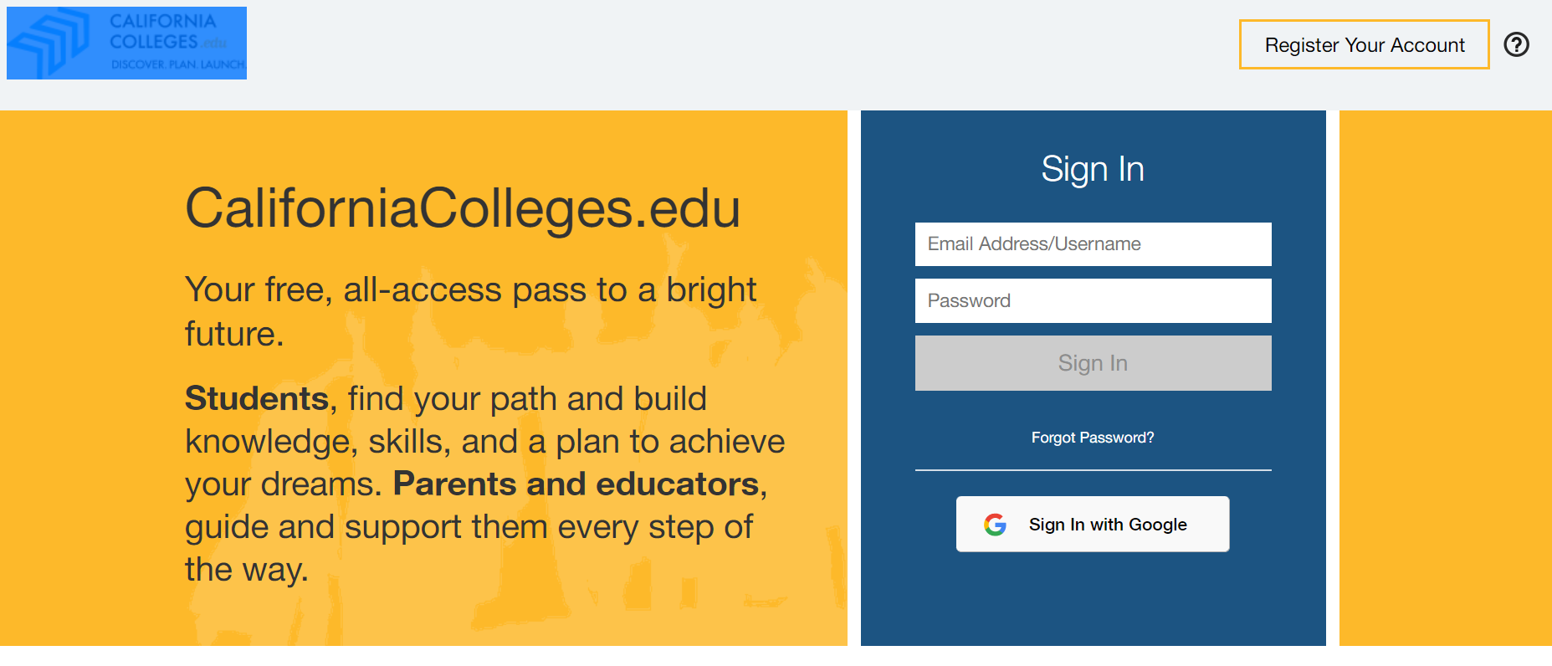
HOW TO LOG ON California Colleges
Click on the Register Your Account on the top right-hand corner

Slide 3
FILL IN 3 BOXES (auto-fill)
I am a STUDENT
Chino Valley Unified
Lyle S Briggs Fundamental

Slide 4
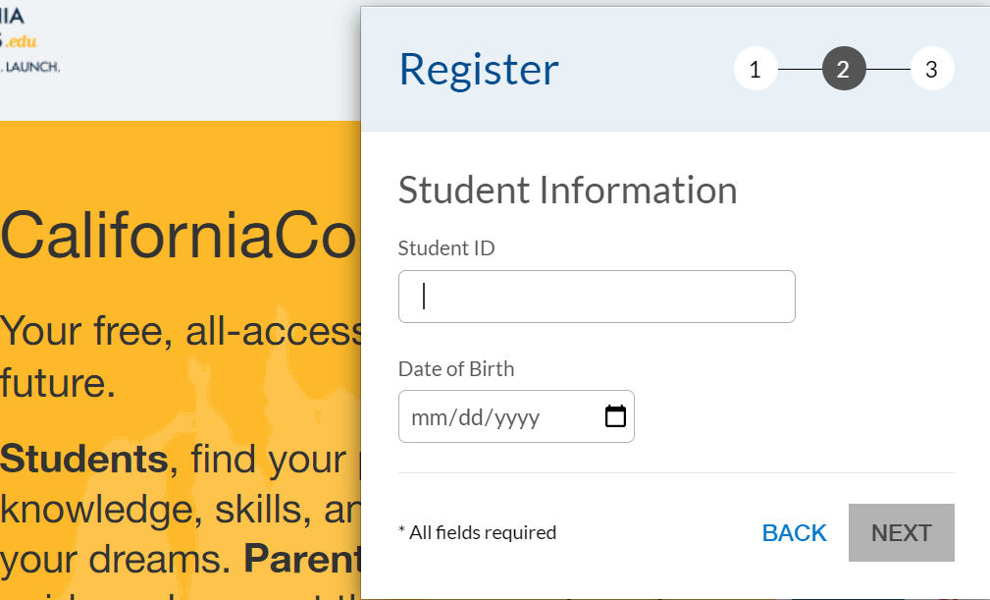
SIGN IN
Student ID: 9-digit number
Date of Birth: mm/dd/yyyy

Slide 5
1. Enter school email address: 9digit id @stu.chino.k12.ca.us 2. The password is the first initial of first name (capitalized), first initial of last name, 2-digit birth month/, two-digit birthday/, and two-digit birth year.
Do not sign up with Google!

Slide 6
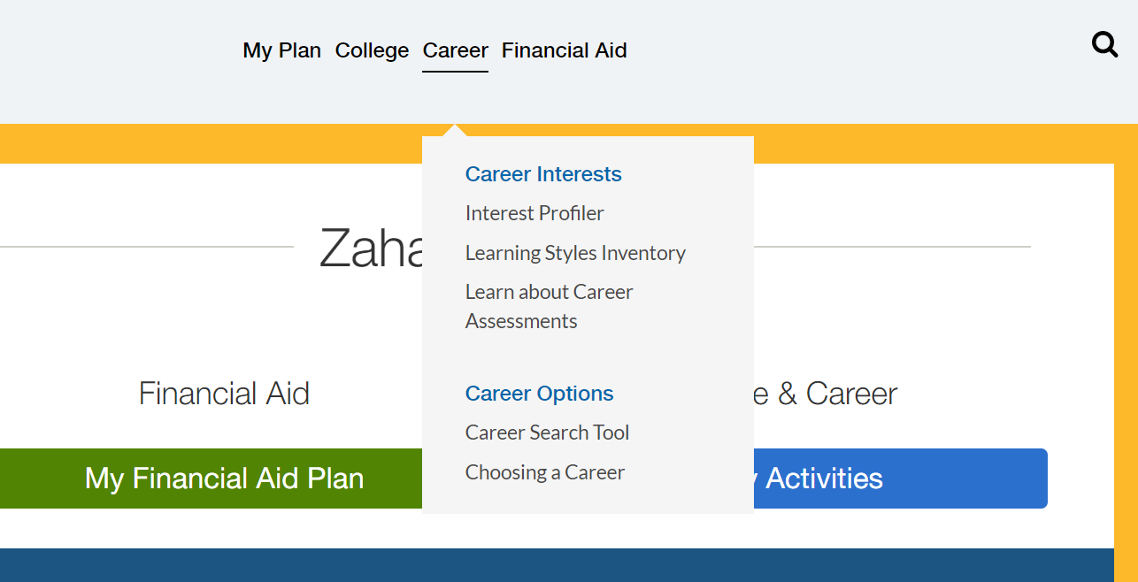
Lesson 8.1 How do I learn?
Hover over Career link
Click on Learning and Productivity
Take your time and carefully review each statement
Review results

Slide 7
REVIEW RESULTS
1. Which preferences make sense to you and reflect what you already know about yourself? Why?
2. Which preferences either surprise you or are new to you? Why?
3. Based on your results, write a brief description of what your perfect learning environment is.

Slide 8
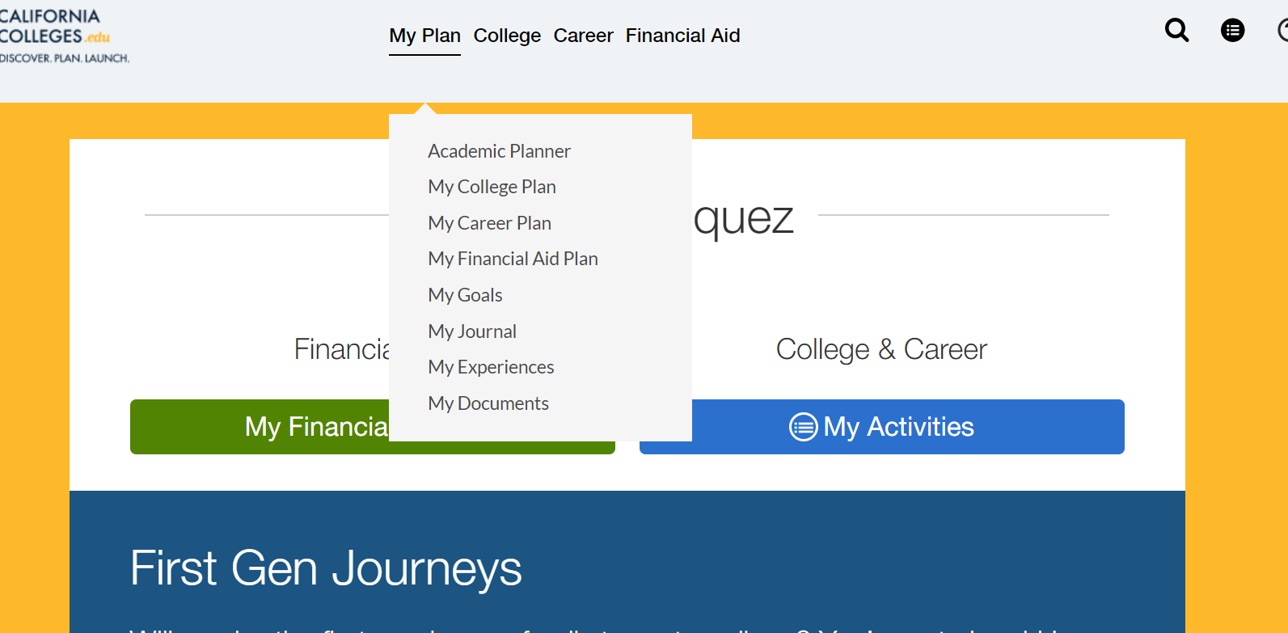
REFLECT
Go to MY PLAN and then JOURNAL. In the ACADEMIC JOURNAL section, find prompt #3:
How can you change your environment to make sure you are doing your best learning?

Slide 9
Mark Task as Complete
Click on MY TASKS icon located in top-right corner of page.
Click on the YOUR ACTIVITIES tab, find the name of this worksheet, and check the completed box.

